Slide 1
Data Science
Jamie Dixon
28 Nov 2023
Notes:
TDD? ADD? HDD?

Slide 2
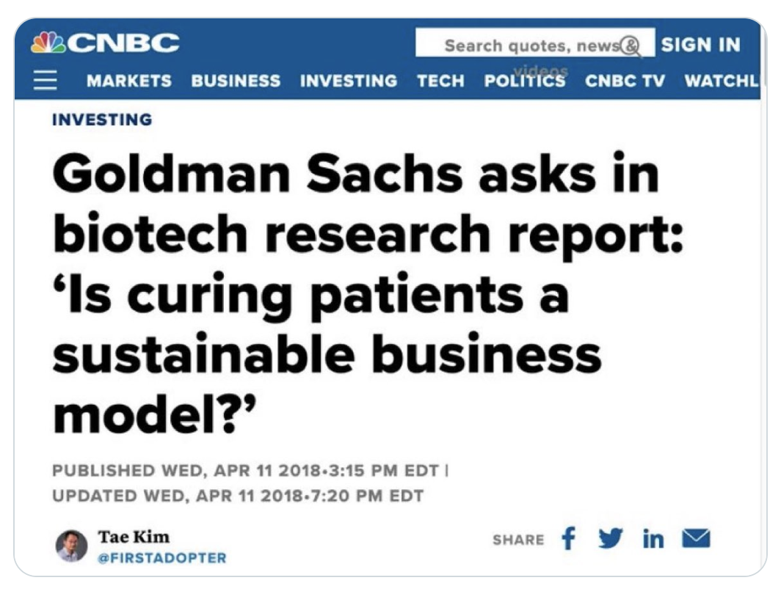
About Me
Writing Code since 1985. Getting paid to do it since 1995.
MPH from Michigan.
Hats |> Software Eng, SE Team Lead, App Architect, NLP Tech Lead, Data Scientist, CTO
Failed PhD applicant. Layer Lab Volunteer. Not giving up.
Interested in curing T1D.

Slide 3
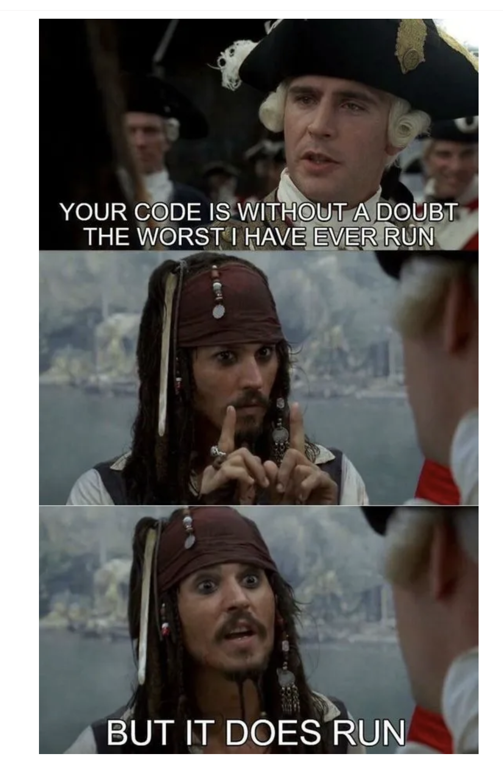
About You
Some data science experience, stats, analytic-prone
You are the elite
You are lucky
Code won. What does that mean for you?
Your ability to be successful is based on:
Ability to use computers
Ability to use other people who use computers
You have to wear many hats: PM, BA, AA, IE, SWE, S&M

Slide 4
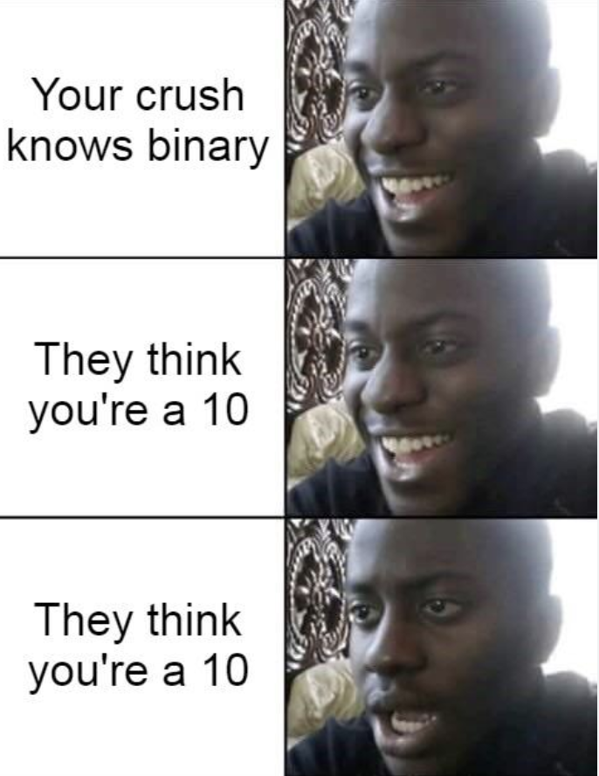
Agenda
Domain Ubiquitous Language
(Refactoring)
Data & Functions (and all functions are a map)
Immutability
Pure and Impure Functions
Dependency Injection
Defensive Programming
Safe Room Architecture
Two Track Architecture
Inside Out Methodology

Slide 5
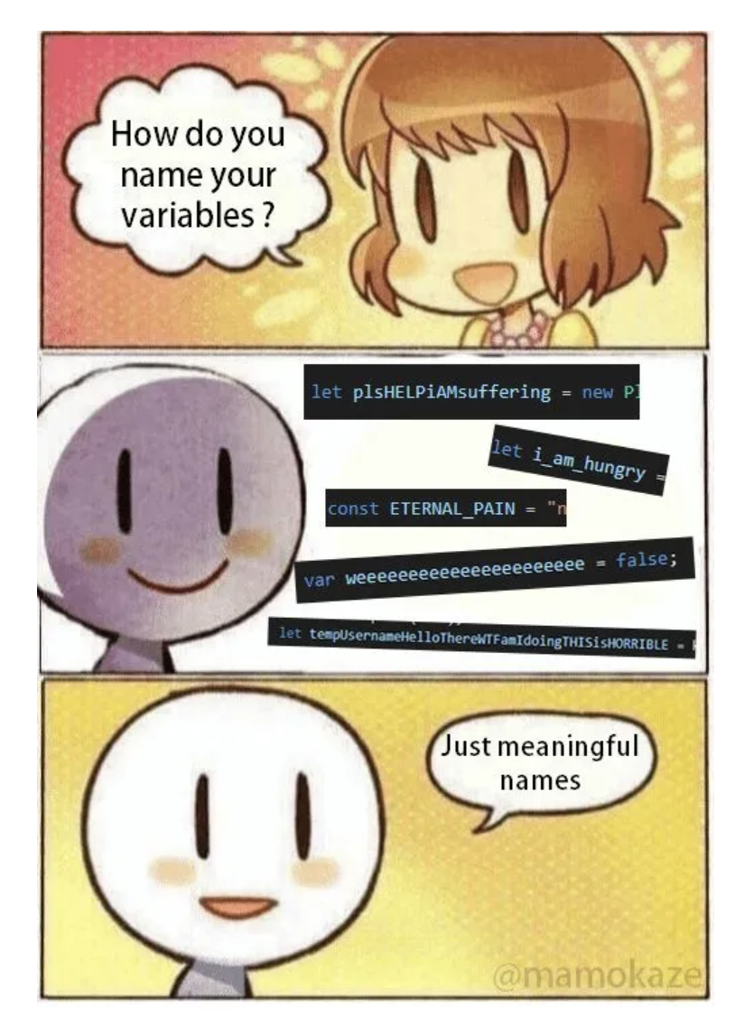
Concept: Domain Ubiquitous Language
In your entire codebase, 1 word means 1 thing only. And always use it.
The software industry has already taken certain words
“index”, “list”, “map”
No such thing as a “file”: “file_path” and “file_contents”
Your domain has already taken certain words – even if they make no sense (“Spectra”)
How much domain knowledge do you need to understand the code? (MFA = Magnetic Field Align)

Slide 6
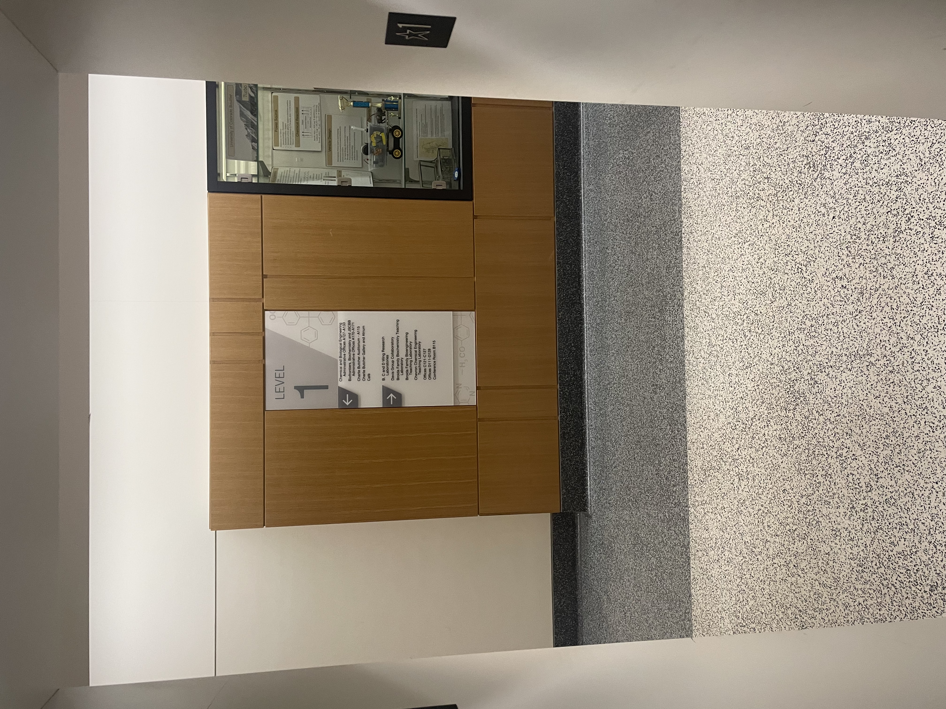
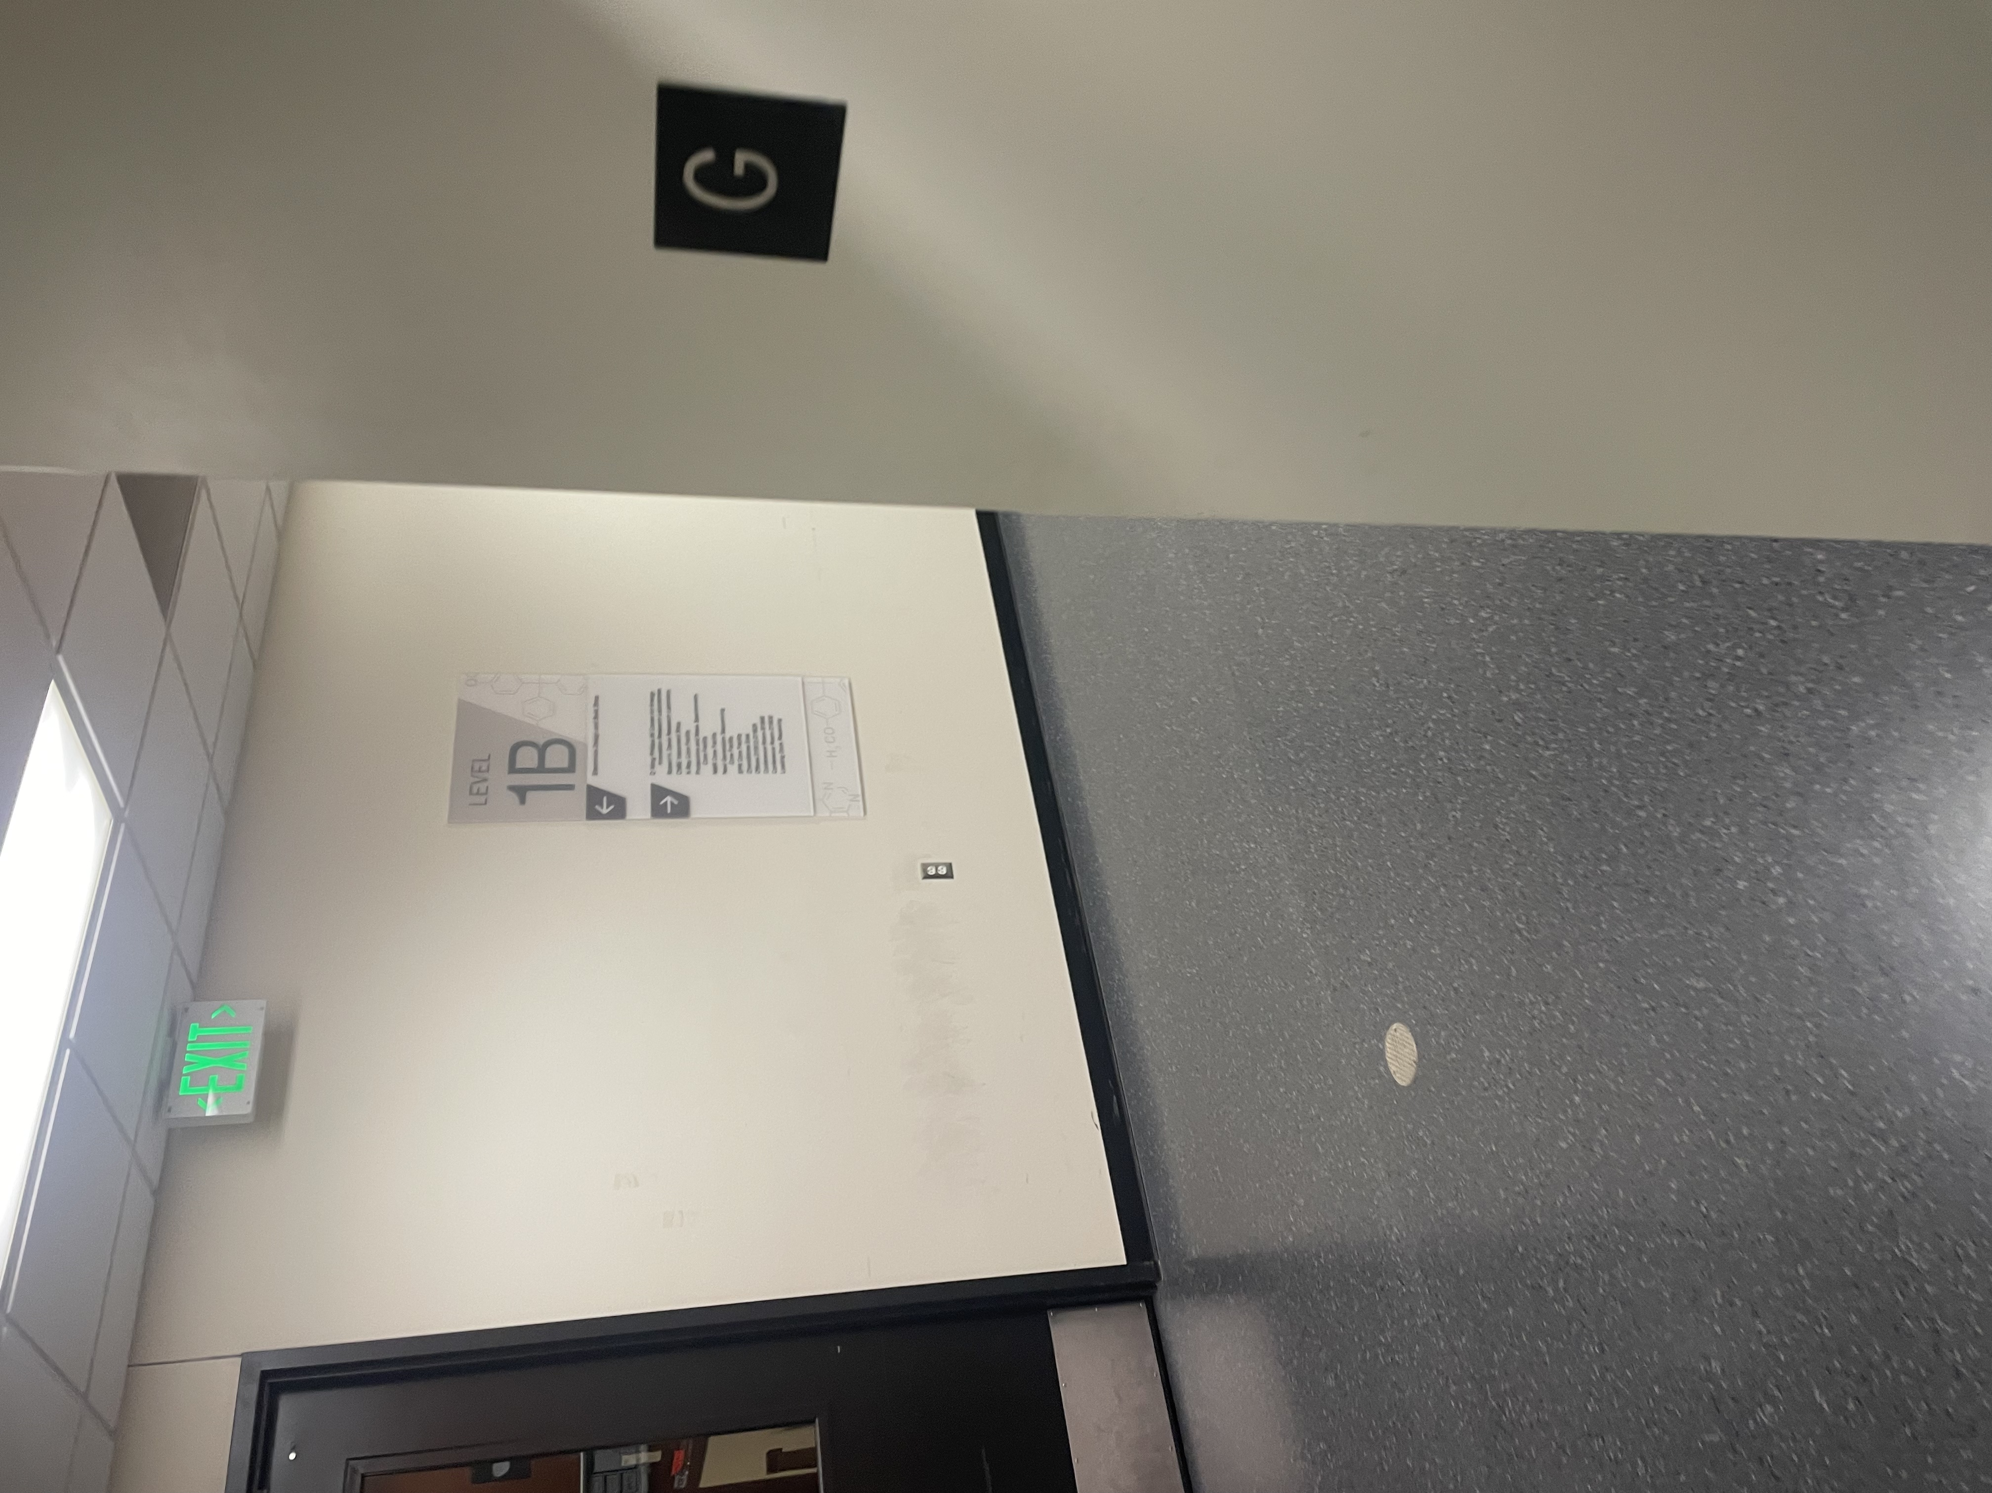
Naming

Slide 7

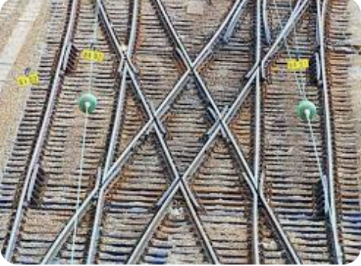
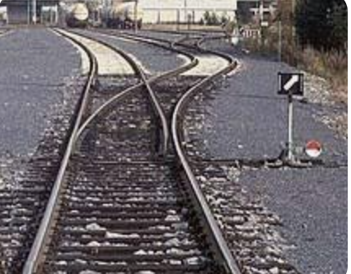
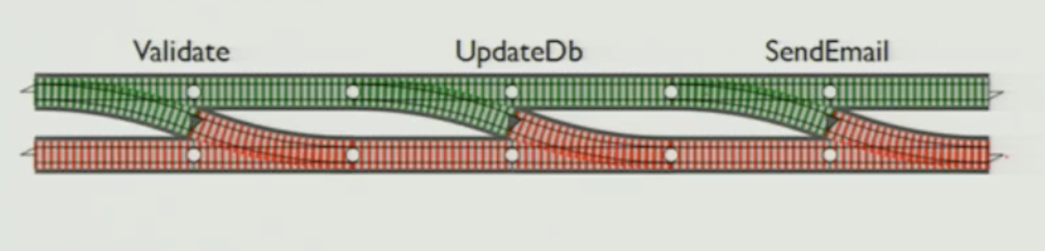
Two Track Architecture
You Think Happy Path
Conditional Expressions turns your code into this
You Want This

Slide 8
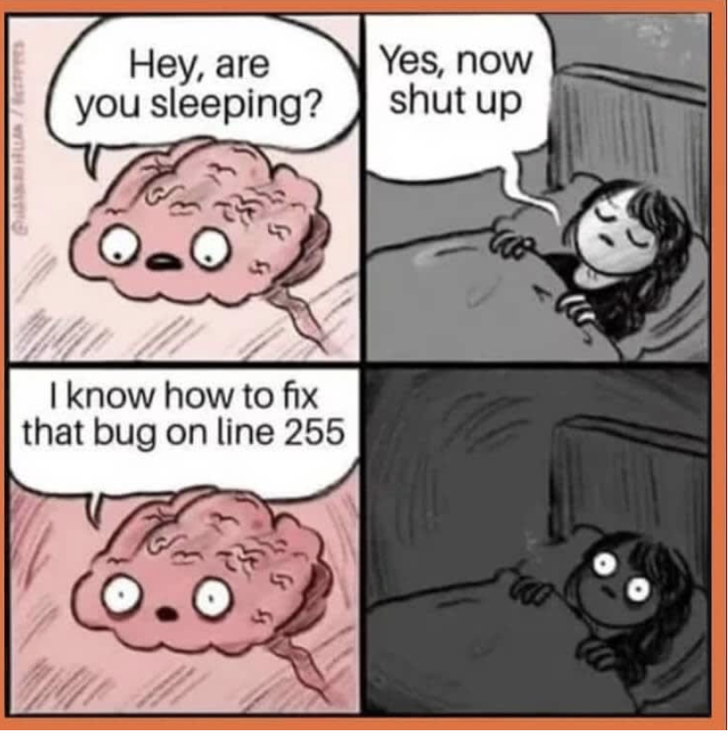
Wrap Up
Questions/Comments/Concerns

